Slide 1
Natural Language Processing with Disaster Tweets: Iteration 1

Slide 2
Roles
Jonathan Tran - Project Manager and Data Analyst
01
Kazuki Susuki - Client Liaison and Data Visualizer
02
Jeampy Kalambayi - Data Modeler and Project Documentation
03

Slide 3
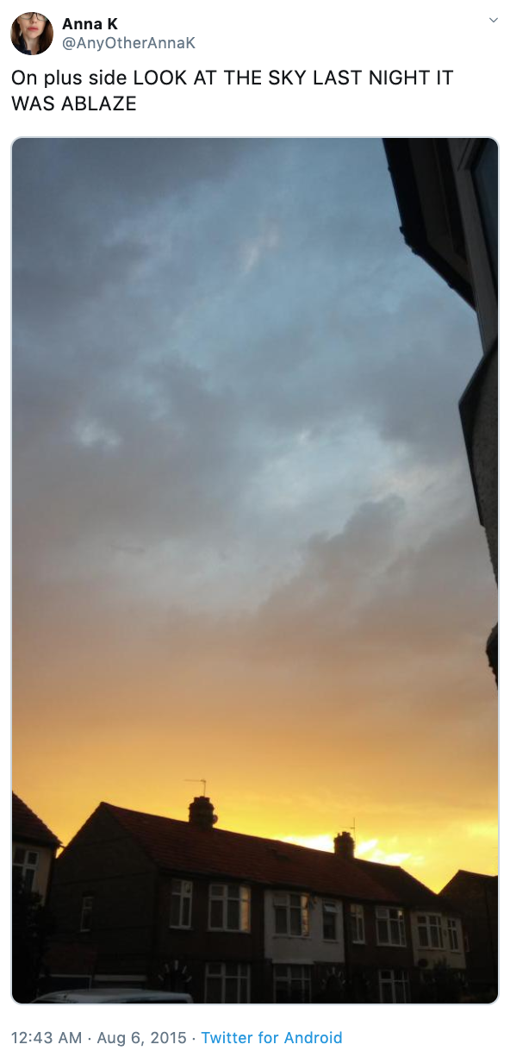
Project Description and Client
Client – Dr. Cengiz Gunay
Project Description – Based on the ongoing Kaggle Competition, create a model to tell the difference between literal and metaphorical tweets. After training and testing the model, the submission will display a 0 or 1to indicate if the tweet is a real disaster or otherwise.

Slide 4
Project Charter
Data Cleaning and Processing: 2/5/2025
01
Data Analysis: 3/19/2025
02
Data Visualization: 4/24/2025
04
Project Submission to Kaggle: TBD
03

Slide 5
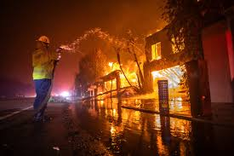
1. Introduction
Predict whether tweets describe real disasters or not.
Dataset: 10,000+ tweets labeled as disaster (1) or non-disaster (0).
Goal: Build a machine learning model for classification.
Predict which Tweets are about real disasters and which ones are not

Slide 6
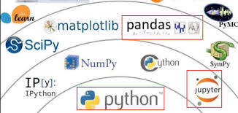
2. Tools & Technologies Used
Programming Language: Python
Libraries: Pandas, NumPy, Scikit-learn, Seaborn, Matplotlib
Machine Learning Model: Logistic Regression
NLP Techniques: TF-IDF, Text Preprocessing
Data Source: Kaggle Dataset (train.csv, test.csv)

Slide 7
3.Dataset Overview
The data set is in the same website: https://www.kaggle.com/competitions/nlp-getting-started/data
To get the data set just click the download button. The system will ask you to sign up if you do have account.
Files
train.csv - the training set
test.csv - the test set
sample_submission.csv - a sample submission file in the correct format

Slide 8
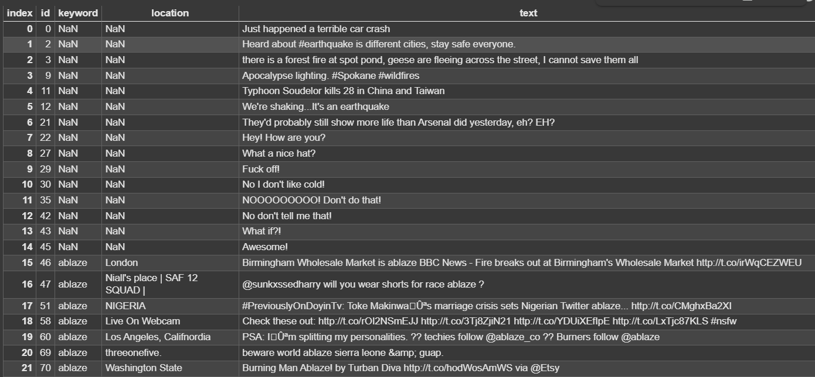
GitHub Repo and Data Collection
Github
Natural Language Prediction with Disaster Tweets

Slide 9
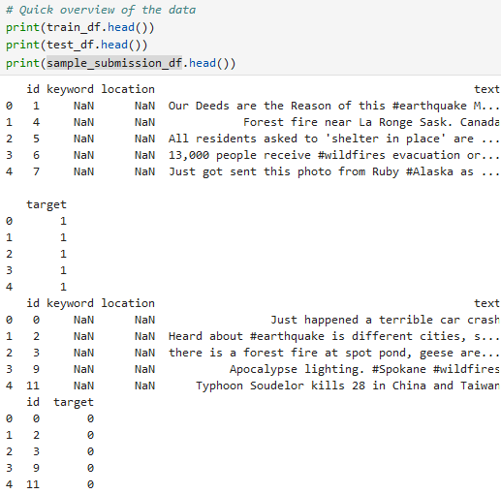
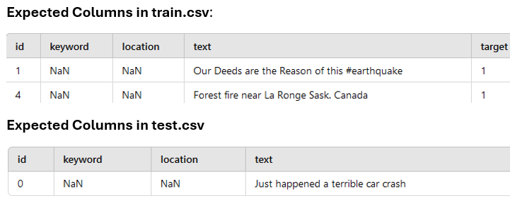
Data Collection and Data Preparation

Slide 10
Data Cleaning
Step 1
Step 2
Check for Missing Values
Drop Duplicates (Keep Only the First Occurrence)
Reset Index
Remove URLs, HTML tags, and special characters.
Convert text to lowercase.
Remove stopwords (e.g., "the", "is", "and").

Slide 11
4: Feature Engineering (TF-IDF)
Convert text into numerical features using TF-IDF.
Extracts important words while ignoring common ones.
Limits vocabulary to 5000 most frequent words.

Slide 12
5: Training the Model
Train a Logistic Regression model on cleaned text data.
Uses TF-IDF vectors as input.
Splits data into 80% training and 20% validation.
Optimized using maximum iterations (200).

Slide 13
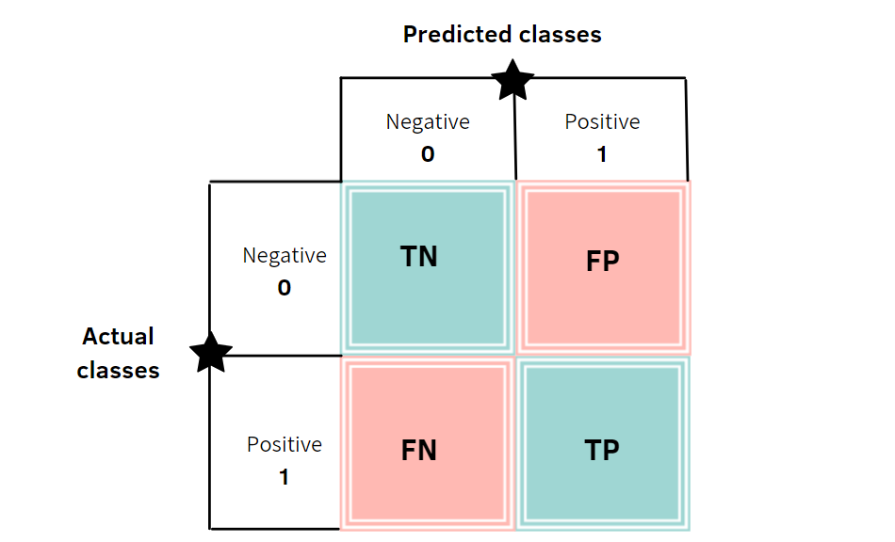
Data Visualization
Plan Create a geographic map of locations with disasters Produce a confusion matrix to define the performance of the model A pie chart showing the class distribution of tweets that are disaster or not disaster. A word cloud of the most common words related to disasters.
Technologies Sklearn, Tableau, Matplotlib

Slide 14
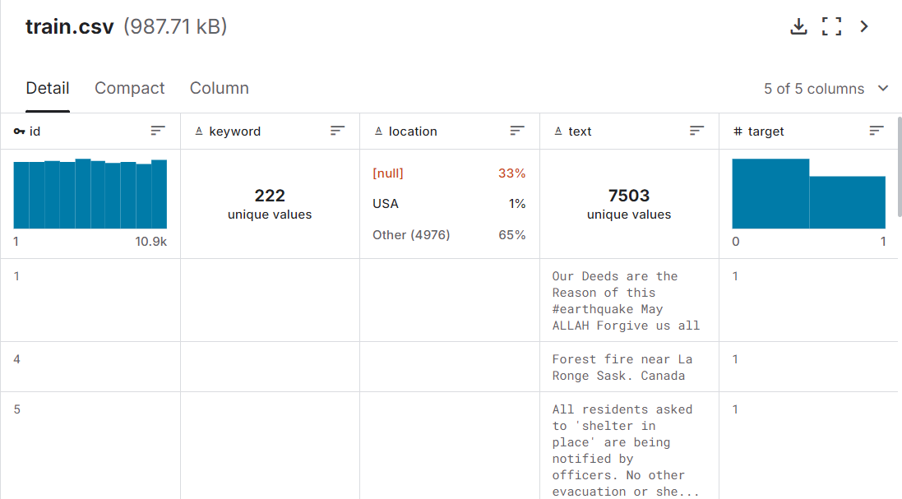

Slide 15
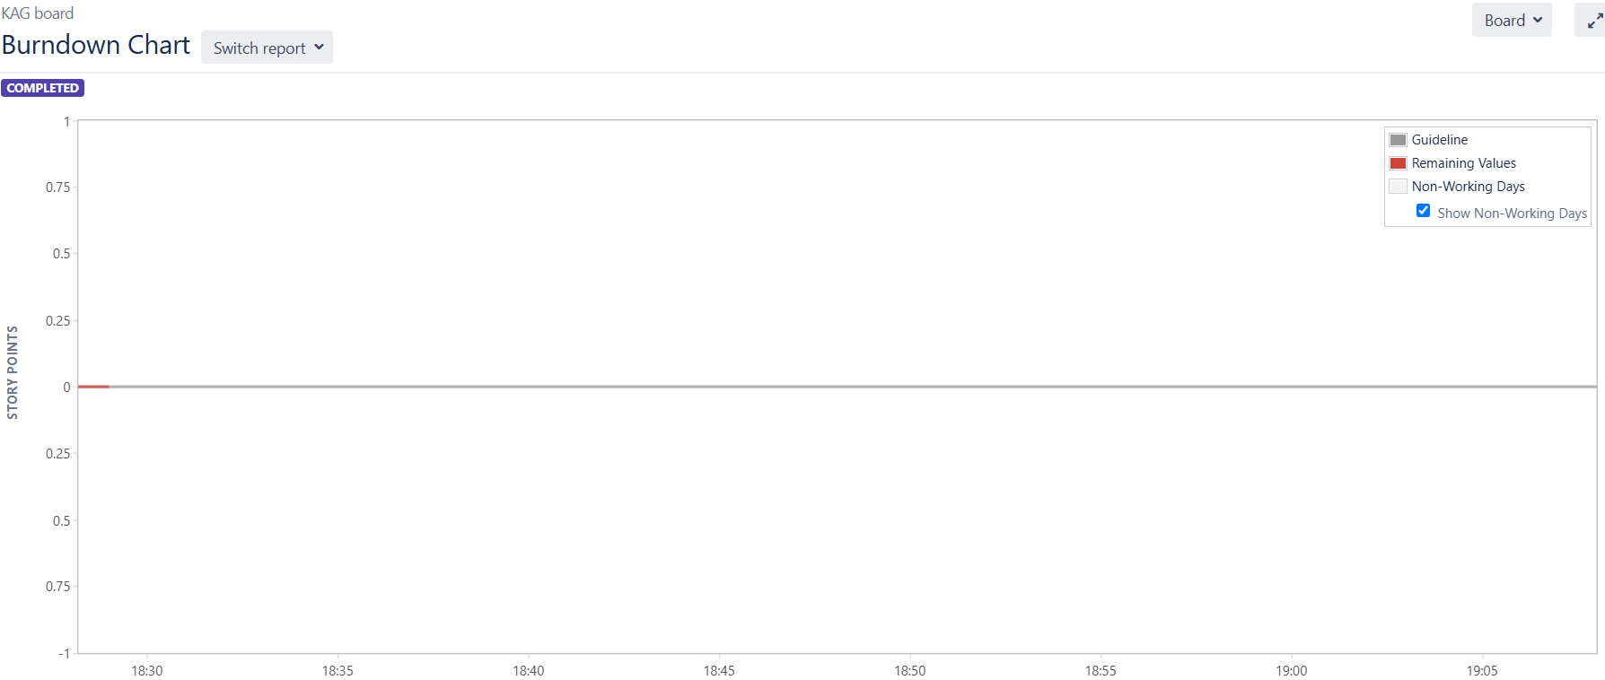

Slide 16
